Slide 1
Open the Machine Learning Black-Box with modelStudio & Arena
Hubert Baniecki, Piotr Piątyszek @Warsaw University of Technology, Poland
useR! - The R User Conference 07.2021

Slide 2
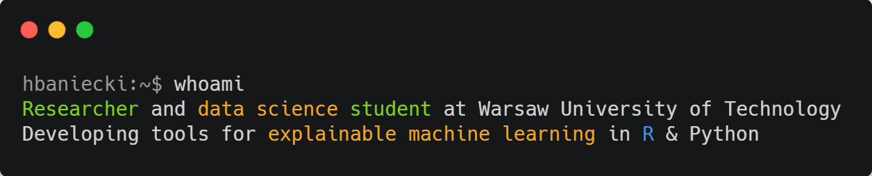



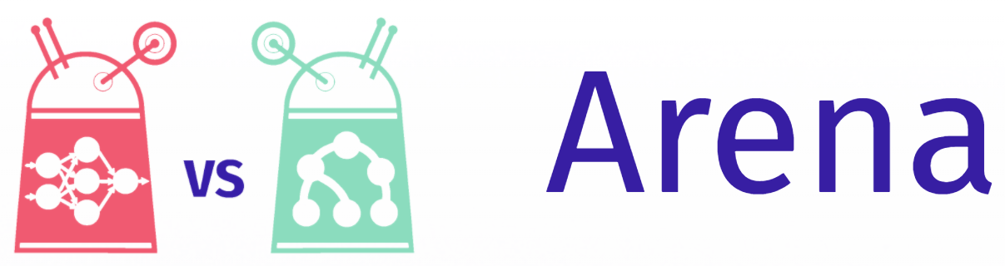
https://hbaniecki.com

Slide 3

Challenges in explanatory model analysis
Various stakeholders
High entry threshold
Reproducibility
A lot of coding…
Automation
Versioning
Interactivity
Customizability

Slide 4
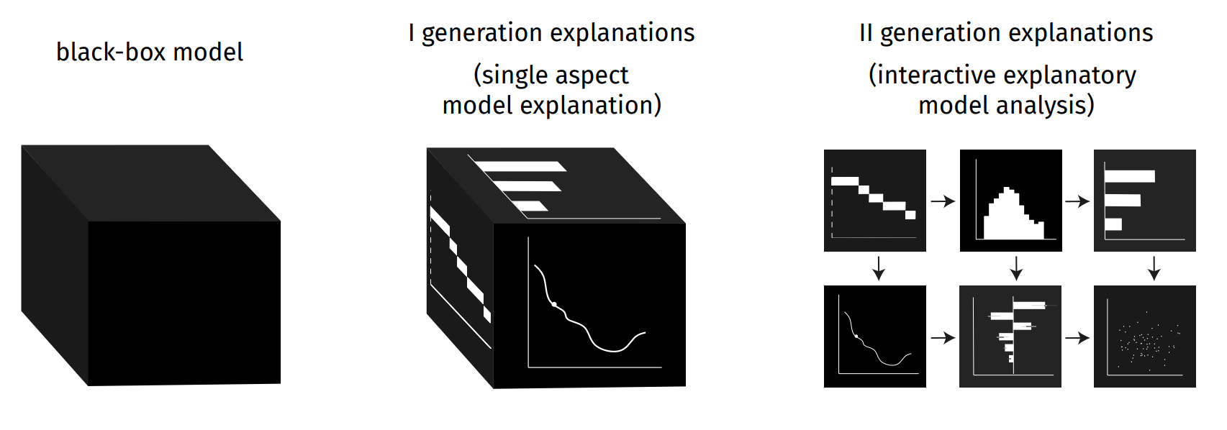
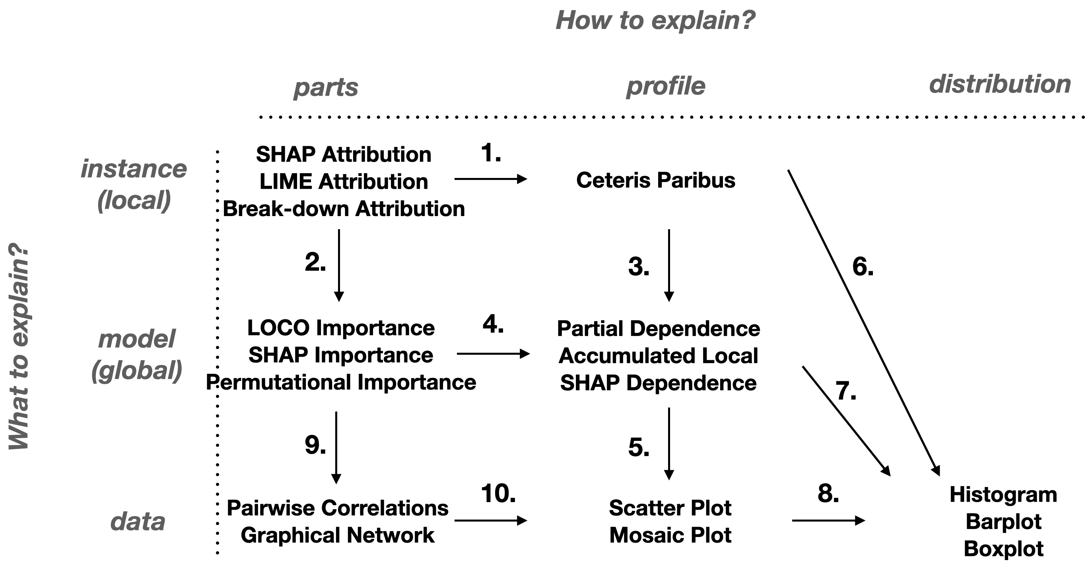
Interactive explanatory model analysis
https://iema.drwhy.ai

Slide 5
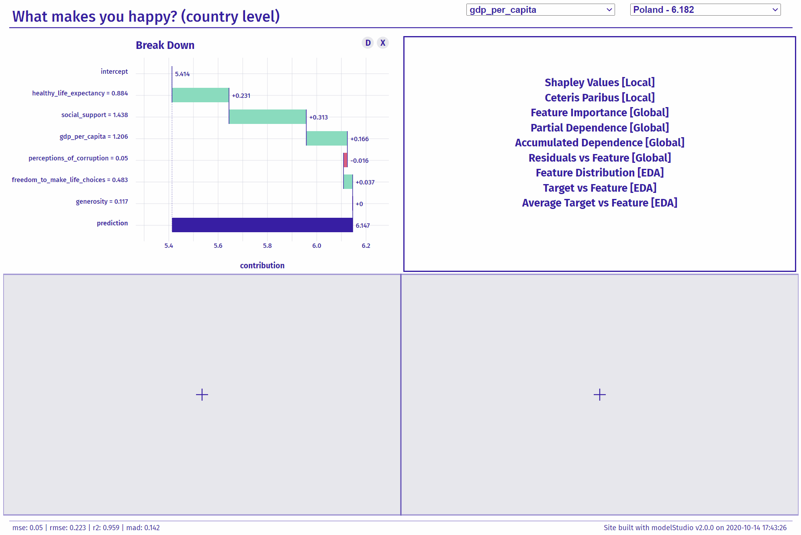
modelStudio
creates a dashboard for model analysis
automated calculations
customizable interface
save & share your analysis
https://github.com/ModelOriented/modelStudio

Slide 6
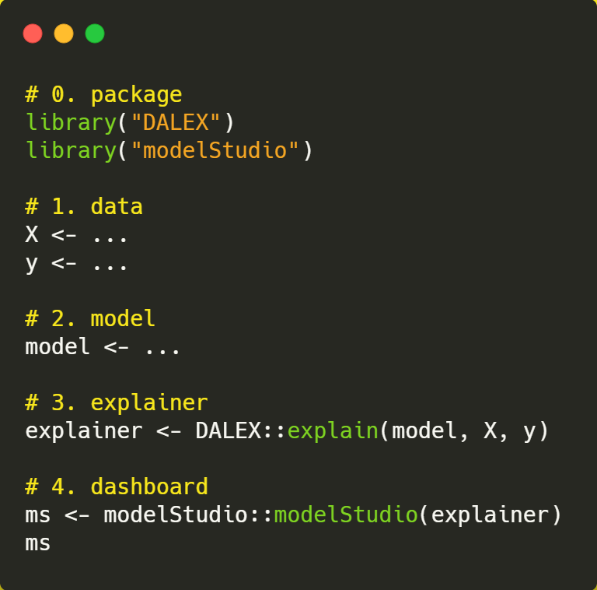
convenient
DEMO: https://github.com/hbaniecki/user-21

Slide 7
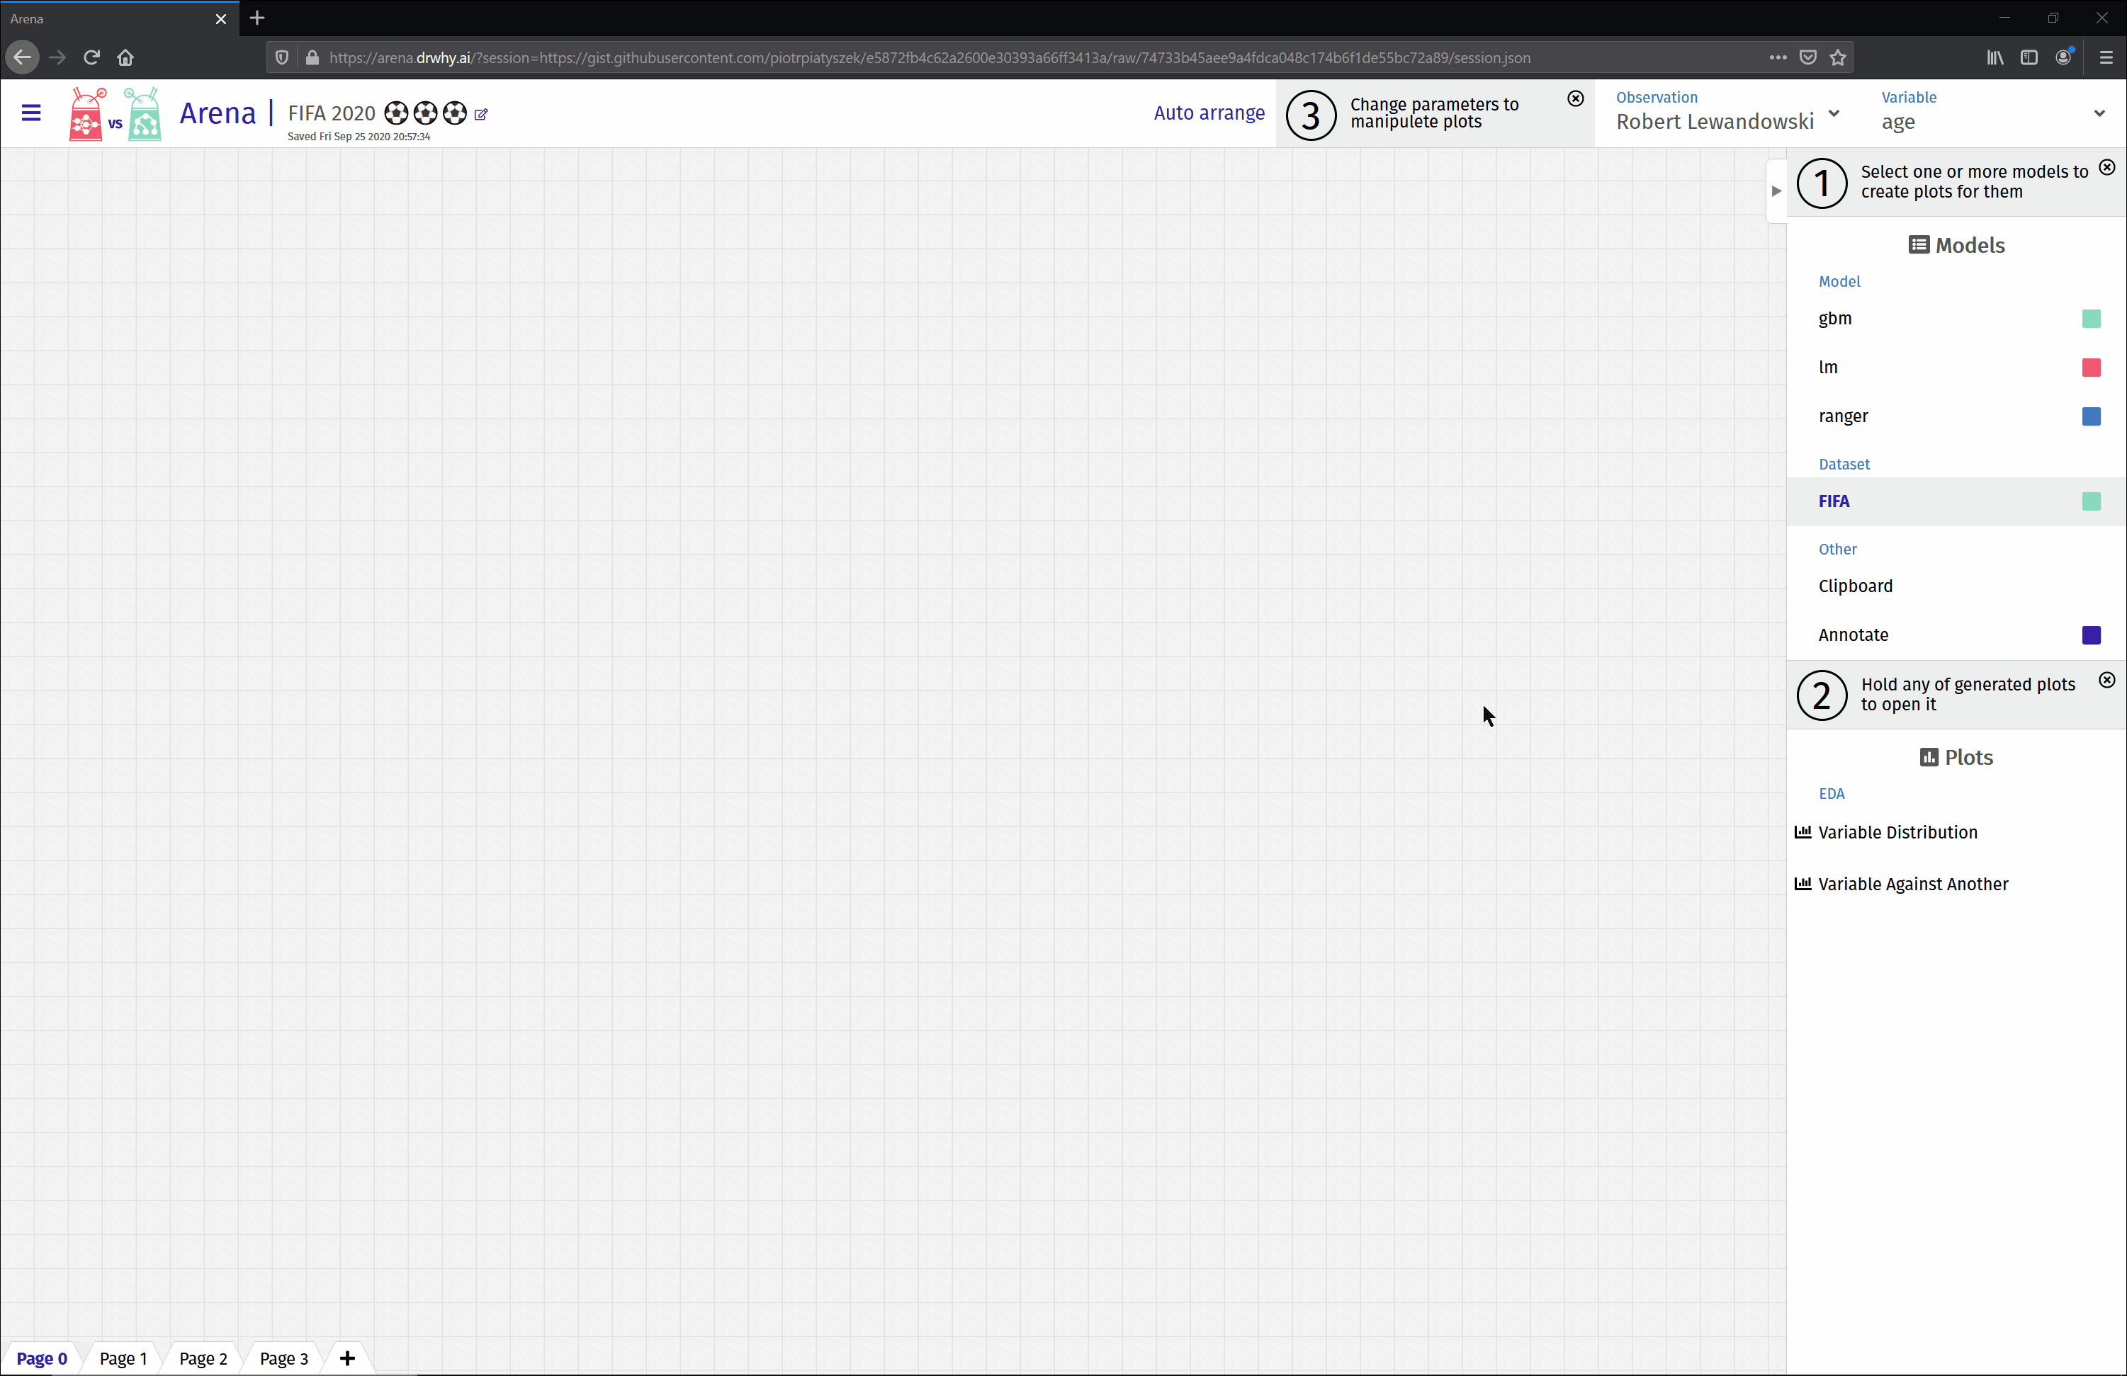
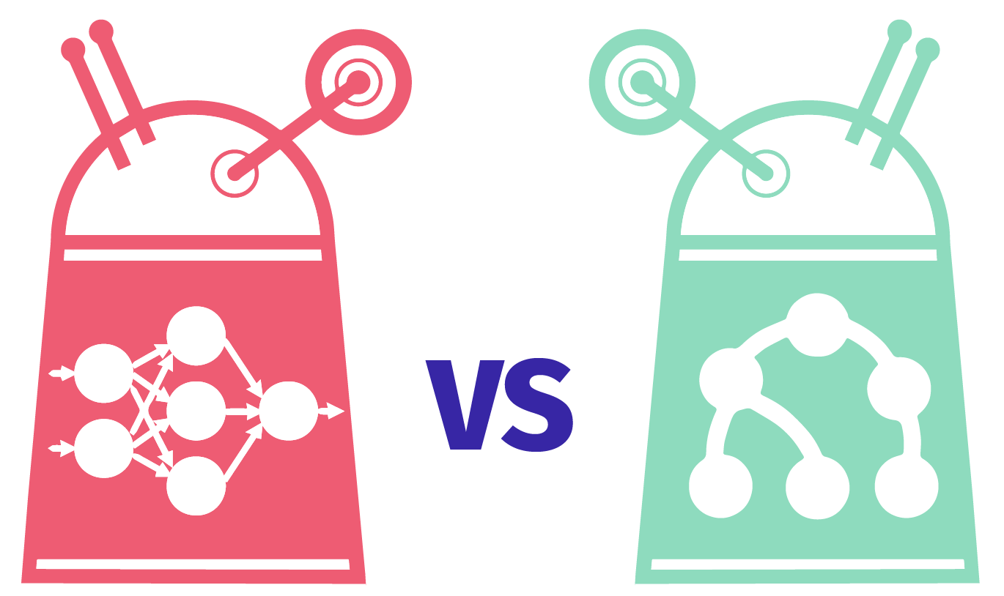
Arena
compare models!
on multiple datasets!!
fairness plots
more pages & cache
still easy to create...
R & Python
http://arena.drwhy.ai

Slide 8
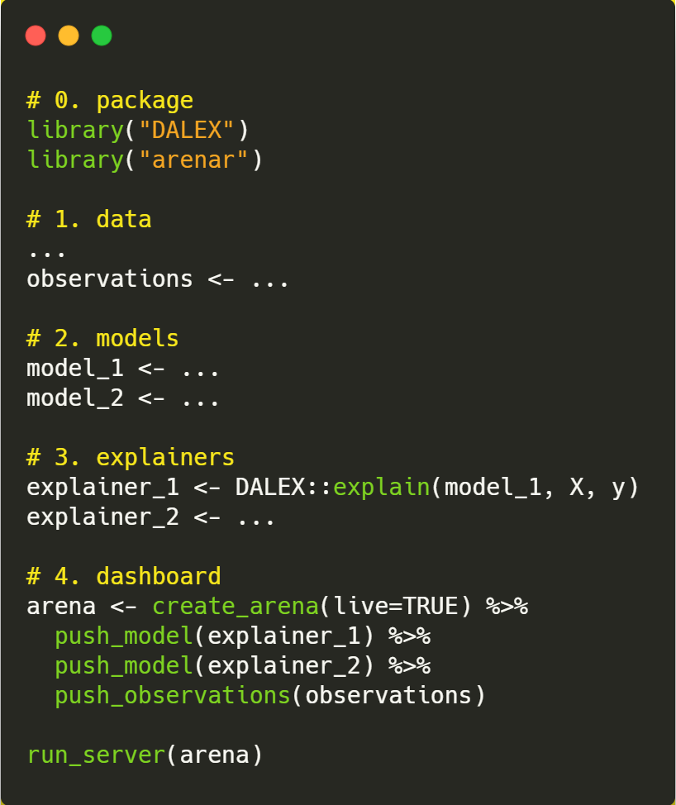
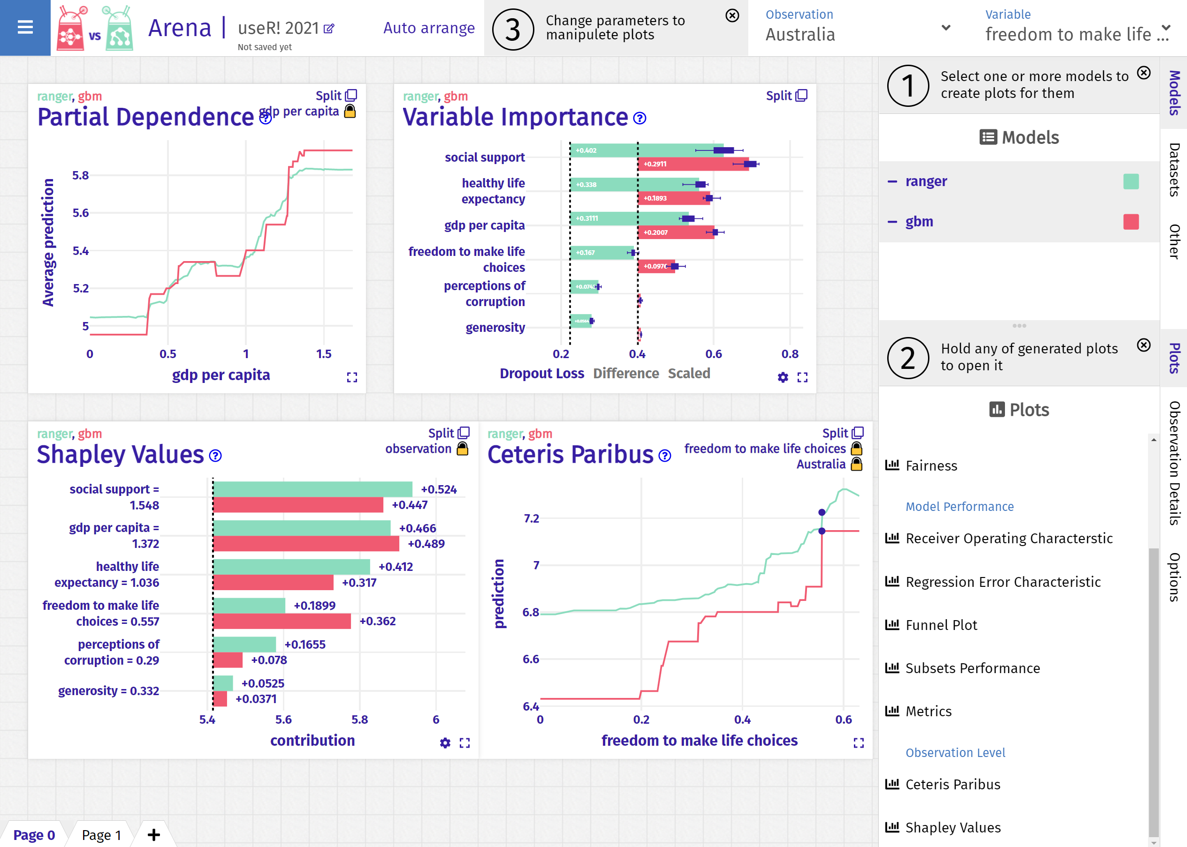
https://github.com/hbaniecki/user-21

Slide 9
Feedback appreciated !
Contact
modelStudio
Arena
hbaniecki.com
github.com/ModelOriented/modelStudio
arena.drwhy.ai

